Slide 1
CAD System
Deep Learning Approach
Tewodros Arega, Abdullah Thabit

Slide 2
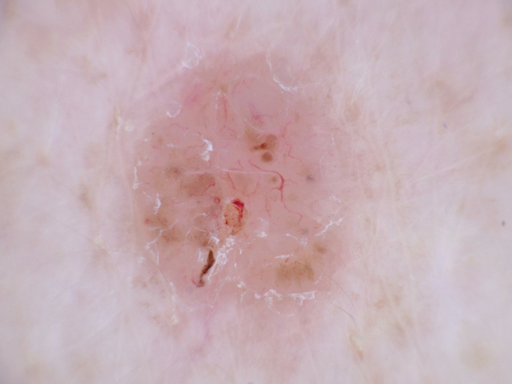
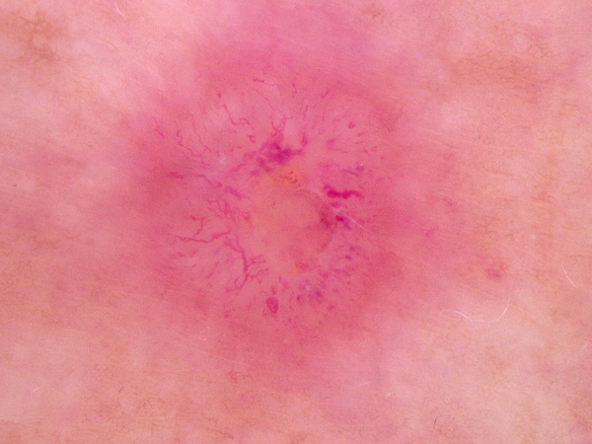
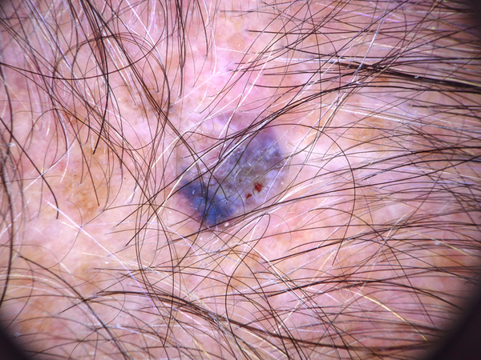
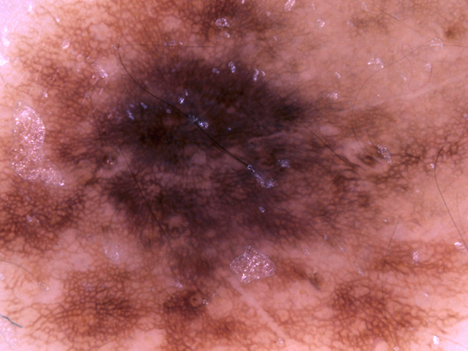




Project Objectives
Build a CAD system to address two main problems:
Skin Lesion Classification
6000 images (half benign and half other classes)
Histopathology Classification
29494 images (half benign and half malignant)

Slide 3
CAD System Framework
Feature Extraction
Classification
Pre-processing
Data Preparation
Benign
Malignant
Deep Learning Model

Slide 4
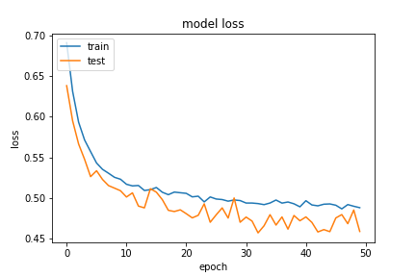
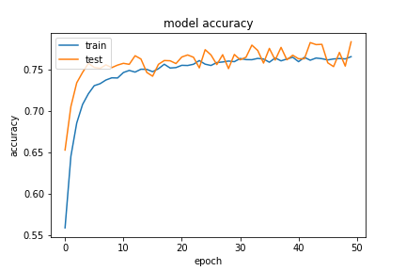
Histopathology Classification
First Experiment: Transfer Learning
VGG16
Resnet50
Initial Hyperparameters:
Optimizer: Adadelta
Lr= 0.001
Epochs = 50
The models Performed about the same
VGG16 (acc) = 77.9%
Resnet50= 78.1%
Training Loss is high meaning the models couldn't learn the dataset very well

Slide 5
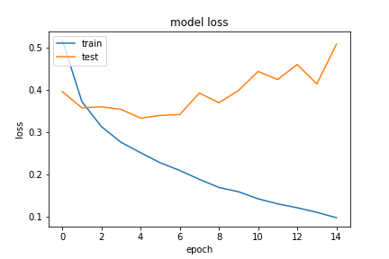
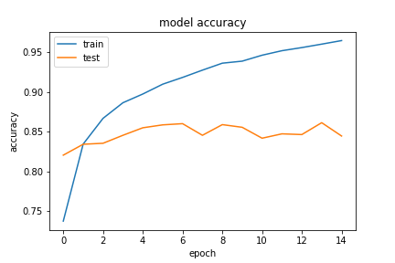
Histopathology Classification
Switch to fine tuning:
Vgg16
Resnet50
Densenet161
VGG16 = 80%
Resnet50= 81%
Densenet161 = 84%
Training loss now goes very low, but there is big over fitting from the first epochs!!

Slide 6
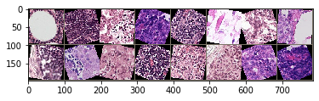
Histopathology Classification
Apply Augmentation:
Contrast and Saturation
Rotation
Flipping

Slide 7
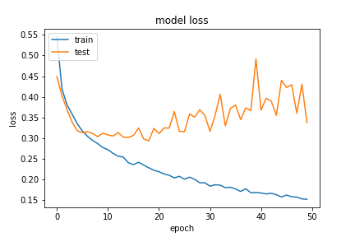
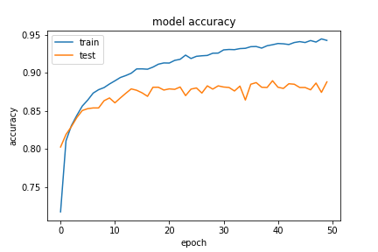
Histopathology Classification
Apply Augmentation:
Vgg16
Densenet161
Resnet50
Resnet34
InceptionV3
The models Performance increased
Vgg16 = 86%
Resnet34 = 86%
Resnet50 = 86%
Densenet161 = 87%
InceptionV3 = 56% (failed)
Overfitting reduced, but still present

Slide 8






Histopathology Classification
Apply Stain Normalization:
Macenko stain normalization 'A method for normalizing histology slides for quantitative analysis’

Slide 9
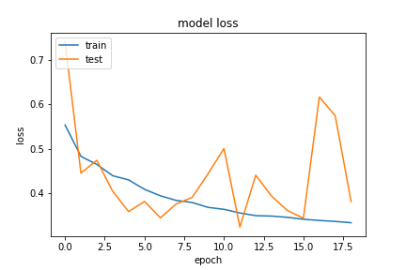
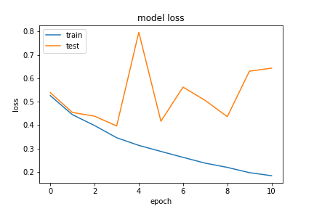
Histopathology Classification
Apply Stain Normalization with two setups:
With Augmentation
Without Augmentation
Applied on Resnet34
The models Performance decreased
Without Augmentation = 82%
With Augmentation = 84%
Stain normalization led to corrupting the features extracted with the deep learning model, and led to a worse performance

Slide 10
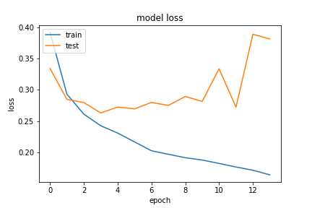
Histopathology Classification
Parameters | Range of options
Optimizer | Adadelta, Adam, SGD
Lr | 0.001 – 0.00001
Weight decay(Adam) | 0.01 – 0.0001
Momentum (SGD) | 0.5 – 0.9
Lr_scheduler | Factor=0.5,0.9 Patience =2, 5
Batch size | 6, 16, 32, 64
Hyperparameter tuning:
Applied on Resnet34
Best parameters found:
Optimizer = SGD
Lr = 0.001
Momentum = 0.9
Lr_scheduler = No
Batch size = 16
Resnet34 = 88.9%
SGD with these parameters converge faster and to a lower loss value, but at the expense of oscillation in loss function!

Slide 11
Histopathology Classification
Apply best parameters on all networks:
MobileNetV2
ResNet18
ResNet34
ResNet50
DenseNet121
DenseNet161
Vgg16
Vgg19
Best model: VGG19
Al models have higher sensitivity than specificity with VGG19 having a balanced sensitivity to specificity ratio and a high accuracy
Model | Accuracy(%) | Sensitivity(%) | Specificity(%)
MobileNetV2 | 89.0 | 91.5 | 86.8
ResNet18 | 88.2 | 95.0 | 83.2
ResNet34 | 89.0 | 91.6 | 86.5
ResNet50 | 88.0 | 91.7 | 85.0
DenseNet121 | 89.0 | 91.8 | 86.5
DenseNet161 | 87.9 | 90.3 | 85.6
Vgg16 | 90.8 | 93.2 | 88.7
Vgg19 | 90.5 | 90.7 | 90.2

Slide 12
Histopathology Classification
Best Model: VGG19
Training Metrics
Accuracy | 93.7%
Per-class Accuracy | 93.3% , 93.9%
Validation Metrics
Accuracy | 90.5%
Per-class Accuracy | 90.3% , 90.8%

Slide 13
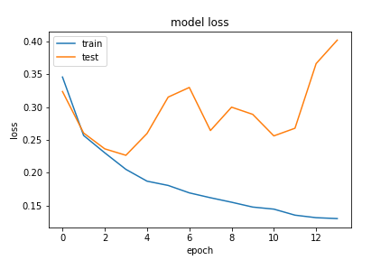
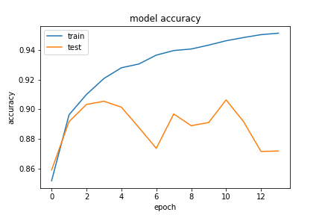
Histopathology Classification
Best Model: VGG19

